Slide 1
Plotting and Models Biology 683 Heath Blackmon
"Remember that all models are wrong; the practical question is how wrong do they have to be to not be useful.”
George Box

Slide 2
Plotting in R
R has always had some plotting capabilities. However, the number of packages that are designed to produce data visualizations has grown dramatically over the last 15 years. Today the plotting landscape is dominated by two largely incompatible ecosystems one in base R and one integrated with the package ggplot2. I use both in my own work.
Base R | ggplot2
Shallow learning curve | Steep learning curve
More freedom to do anything you want to do | Many good decisions are default behavior

Slide 3
ggplot2 (data)
wide data
long data
Rate | Time
1.202 | 1
1.301 | 1
0.987 | 1
2.013 | 1
1.750 | 1
1.45 | 2
1.271 | 2
0.654 | 2
2.458 | 2
1.989 | 2
time 1 | time 2
1.202 | 1.45
1.301 | 1.271
0.987 | 0.654
2.013 | 2.458
1.750 | 1.989

Slide 4
ggplot2 (grammar)
Heath made the cool plot.
Noun
Verb
Article
Adjective
Noun
Heath
made
the
cool
plot
Heath
made
the
horrible
plot
Heath
fixed
the
horrible
plot

Slide 5
ggplot2 (grammar)
Grammatical elements in ggplot2
Element | Description
data | The data being plotted
aesthetics | The scales onto which we plot our data
geometries | The visual elements used for our data
facets | Splitting plots into multiples based on a variable
statistics | Ways of summarizing data
coordinates | The space on which data will be plotted
themes | Aspects unrelated to the data

Slide 6
ggplot2 (simple example)
data
aesthetic
geometry
In this case I wanted an XY scatter plot so these aesthetics make sense. Depending on the geometry you will you will use other things may make more or less sense to include. Some common options include: x, y, fill, col, shape, size.

Slide 7
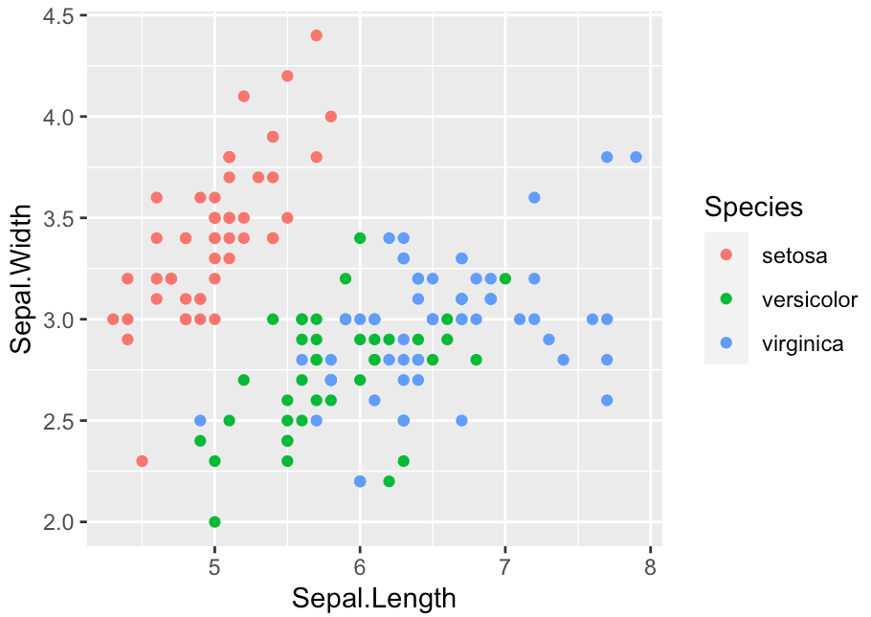
ggplot2 (simple example)

Slide 8
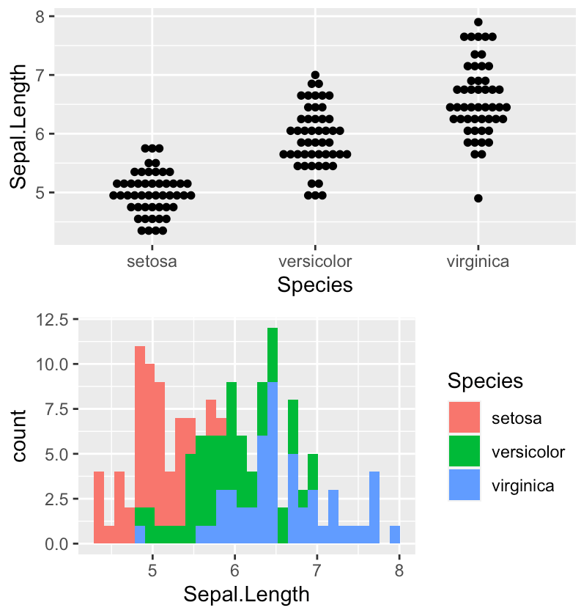
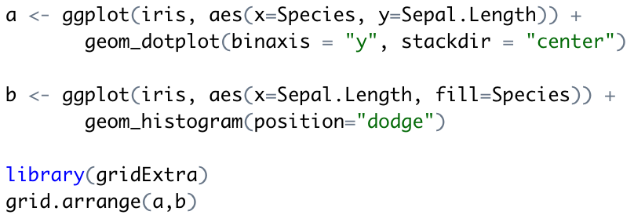
ggplot2 (simple example)

Slide 9
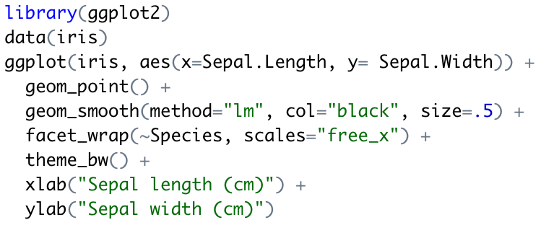
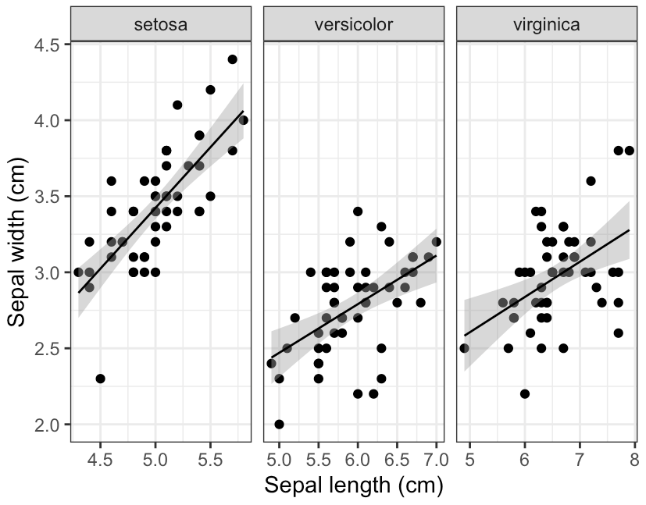
ggplot2 (nicer example)

Slide 10
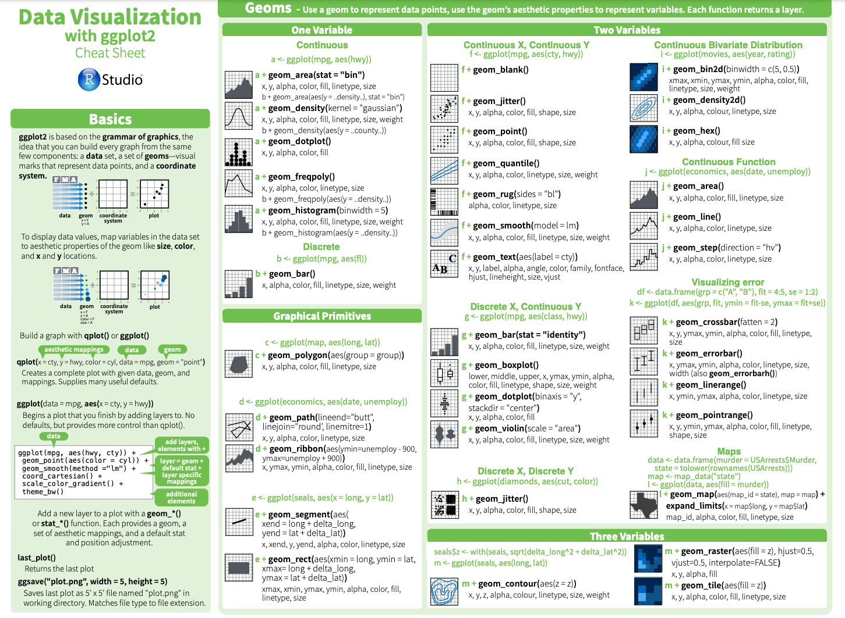
ggplot2 (cheat sheet)

Slide 11
ggplot2 (cheat sheet)

Slide 12

ggraptR – a gentle transition to ggplot

Slide 13
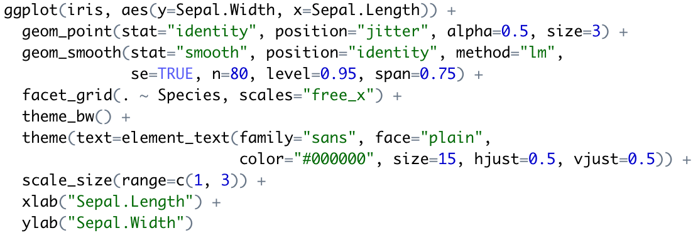
ggraptR – a gentle transition to ggplot

Slide 14
Homework
Using the betta data and ggplot2 make an awesome plot that includes 3 variables (2 continuous and 1 discrete) – Due by Tuesday class time.

Slide 15
Correlation vs Regression
Both methods are ways to explore contingency between variables.
Regression describes the degree to which we can predict the value of one variable based on the value of another.
Regression calculates a line that describes this relationship between two variables.
Use regression when you believe there is a strong case for causation.

Slide 16
Correlation vs Regression
Both methods are ways to explore contingency between variables.
Regression describes the degree to which we can predict the value of one variable based on the value of another.
Regression calculates a line that describes this relationship between two variables.
Use regression when you believe there is a strong case for causation.

Slide 17
Terminology
Linear regression vs.
OLS regression (Ordinary least squares regression) vs.
General linear models vs.
Generalized linear model

Slide 18
Terminology
Linear regression vs.
OLS regression (Ordinary least squares regression) vs.
General linear models vs.
Generalized linear model
glm

Slide 19
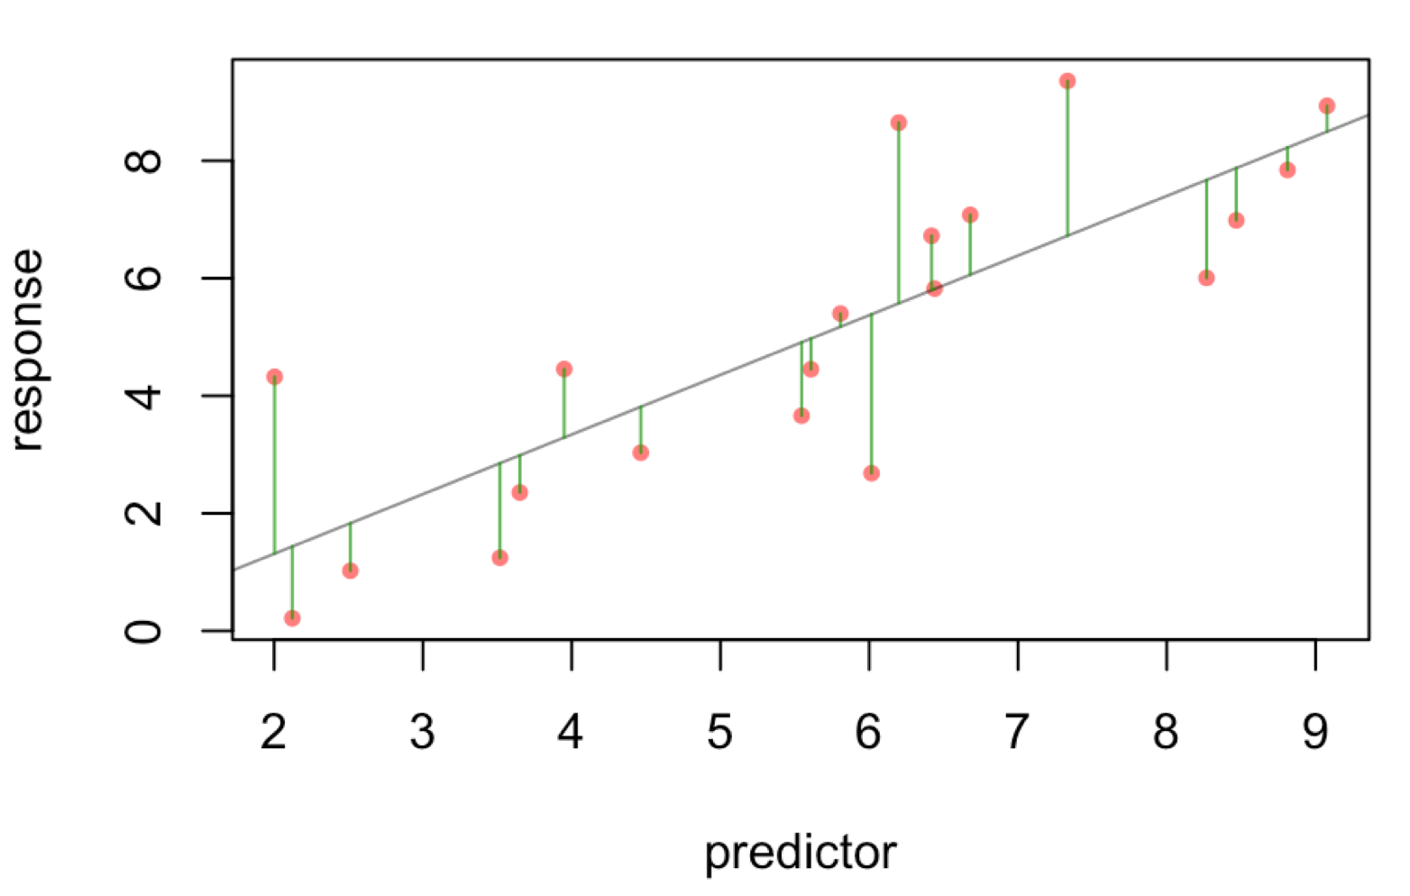
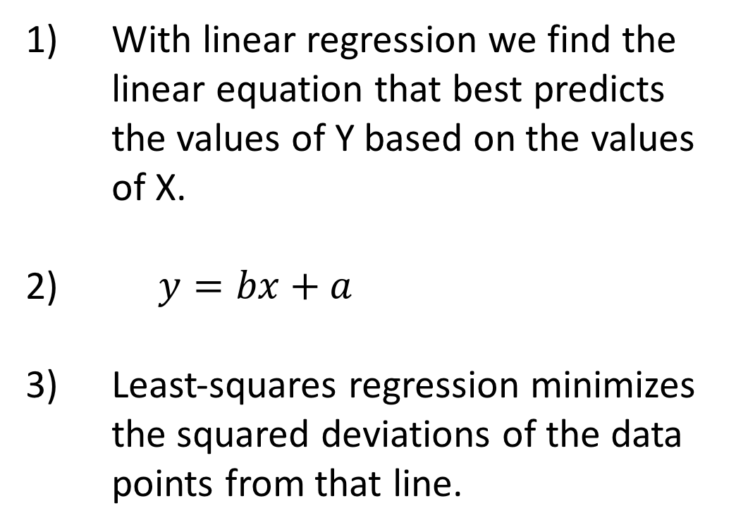
Regression in R
With linear regression we find the linear equation that best predicts the values of Y based on the values of X.
$y=bx+a$
Least-squares regression minimizes the squared deviations of the data points from that line.

Slide 20
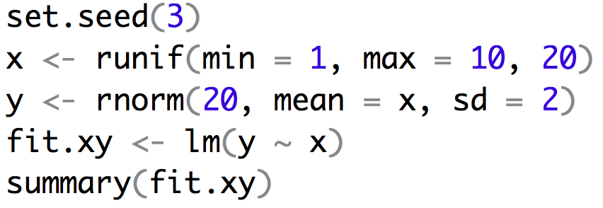
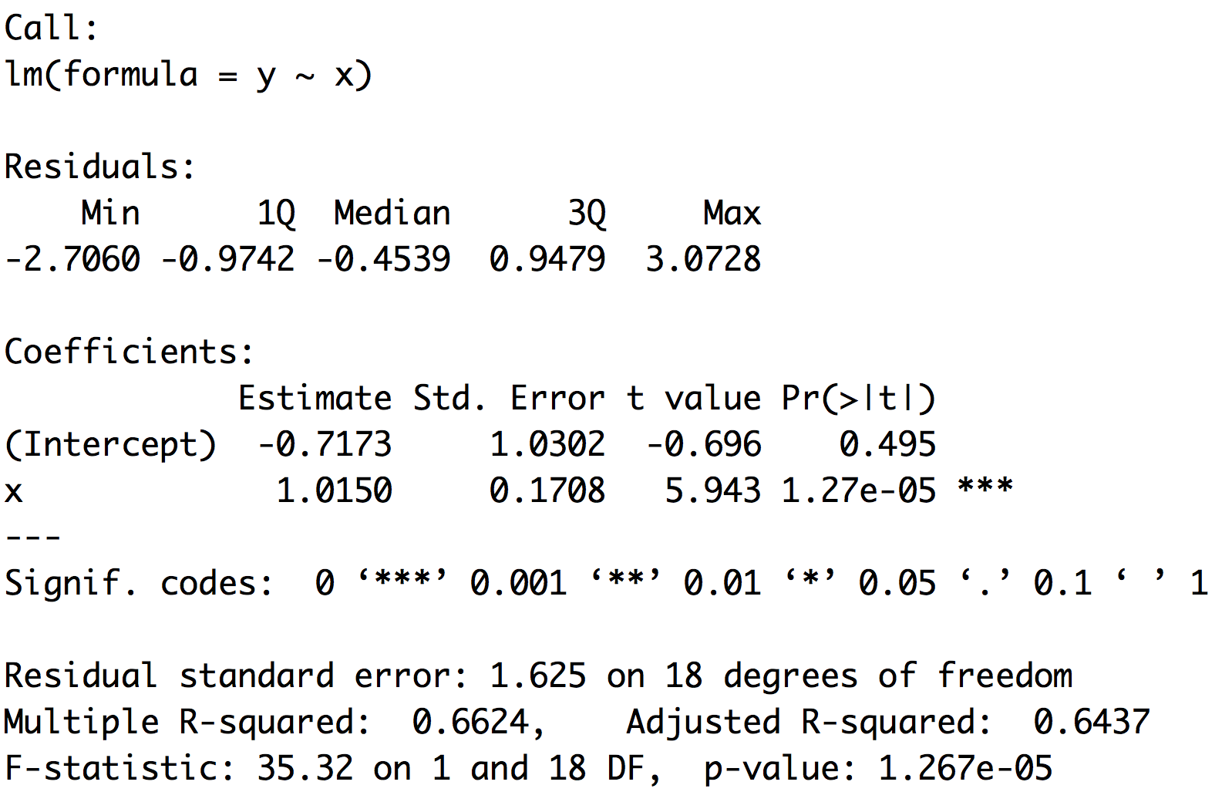
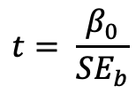
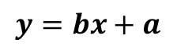
Example of regression
$$y=bx+a$$
$$t= \frac{β_{0}}{{SE}_{b}}$$

Slide 21
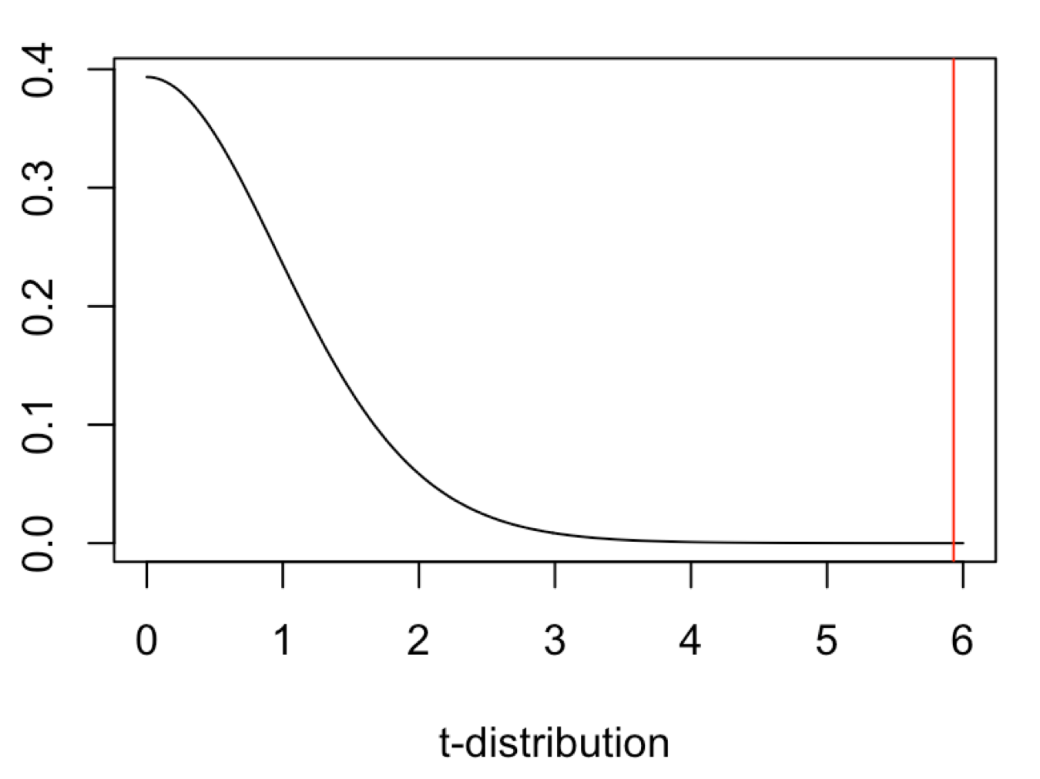
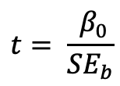
Example of regression
$$y=bx+a$$
$$t= \frac{ β_{0}}{{SE}_{b}}$$

Slide 22
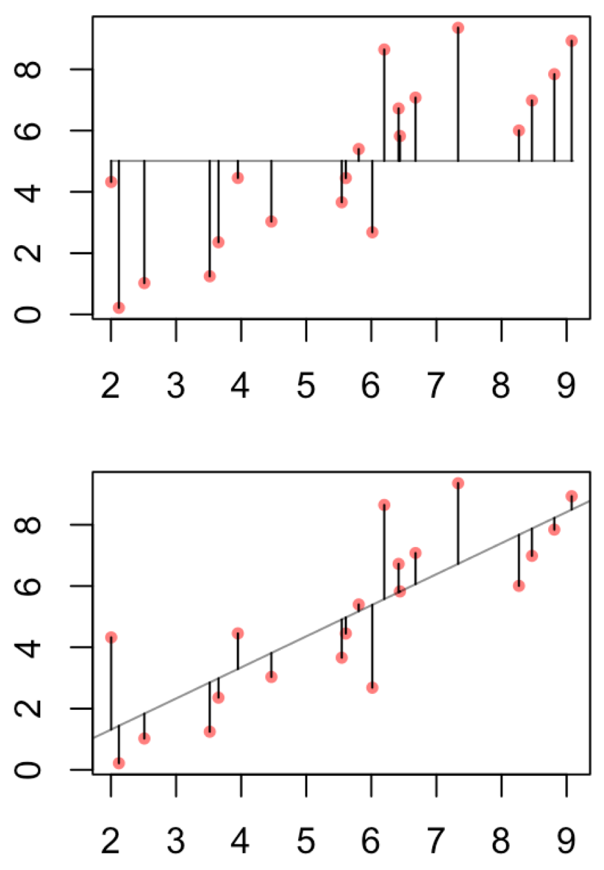
Example of regression
This can help to justify the biological importance
assuming you have a regression that is significant.
It is the proportion of total variance explained by
the regression.

Slide 23
Multiple vs Adjusted R-squared
Adjusted R-squared penalizes for additional parameters

Slide 24
Linear regression uses
Depict the relationship between two variables in an eye-catching fashion
Test the null hypothesis of no association between two variables
The test is whether or not the slope is zero
Predict the average value of variable Y for a group of individuals with a given value of variable X
variation around the line can make it very difficult to predict a value for a given individual with much confidence
Predictions outside of the range of observed data is generally discouraged
Used both for experimental and observational studies

Slide 25
What are Residuals
In general, the residual is the individual’s departure from the value predicted by the model
In this case the model is simple – the linear regression – but residuals also exist for more complex models
For a model that fits better, the residuals will be smaller on average
Residuals can be of interest in their own right, because they represent values that have been corrected for relationships that might be obscuring a pattern.

Slide 26
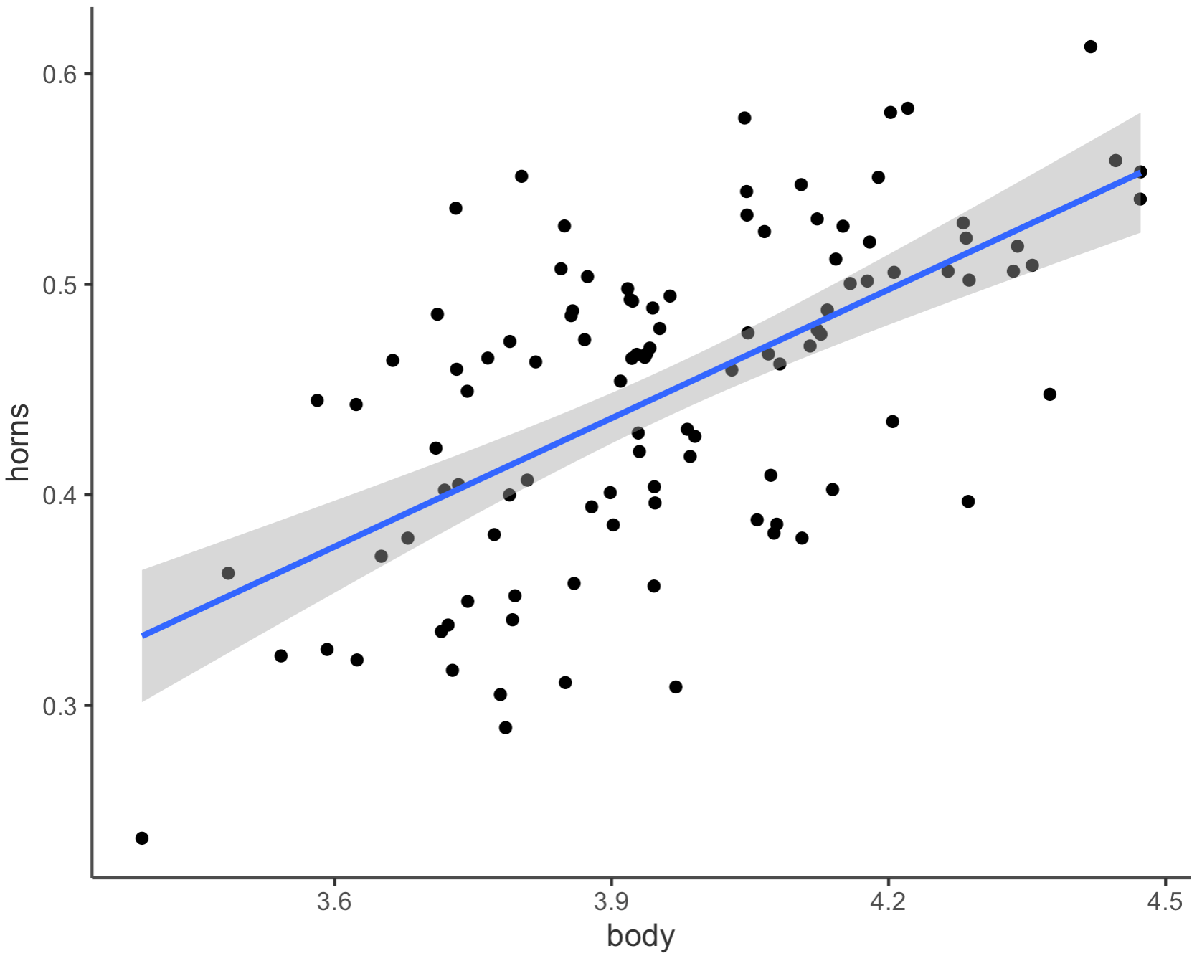
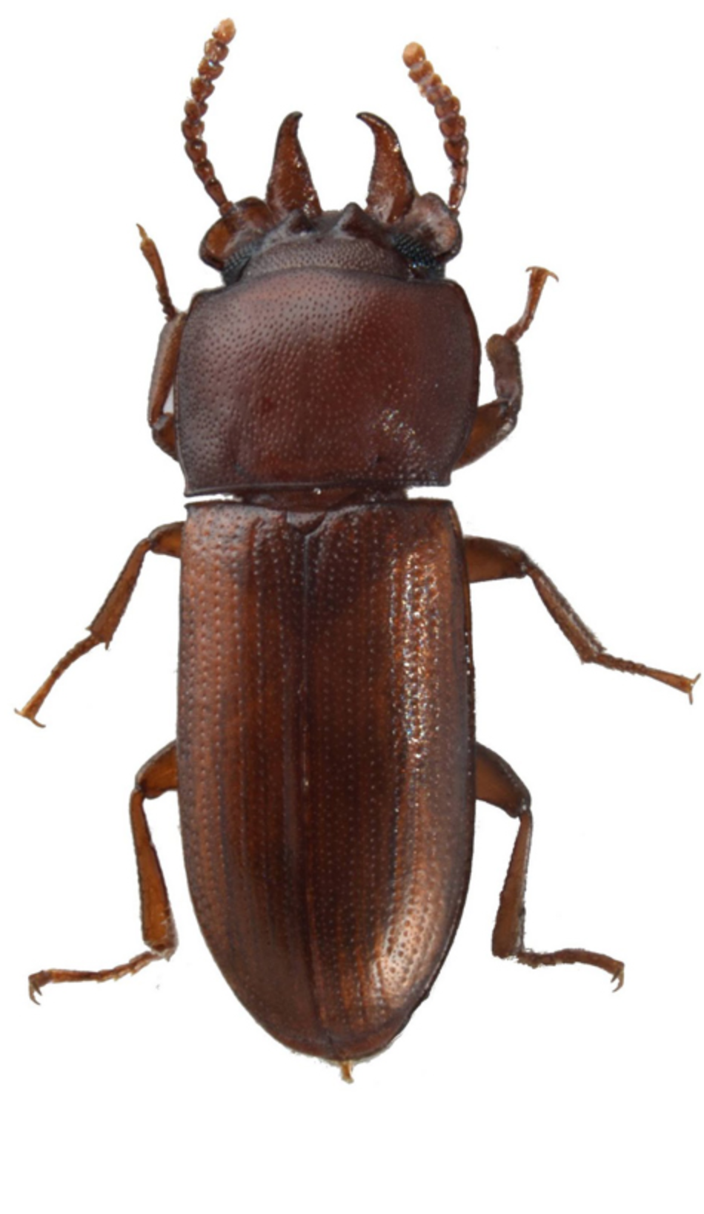
What are Residuals
Horn Size
Body Size

Slide 27
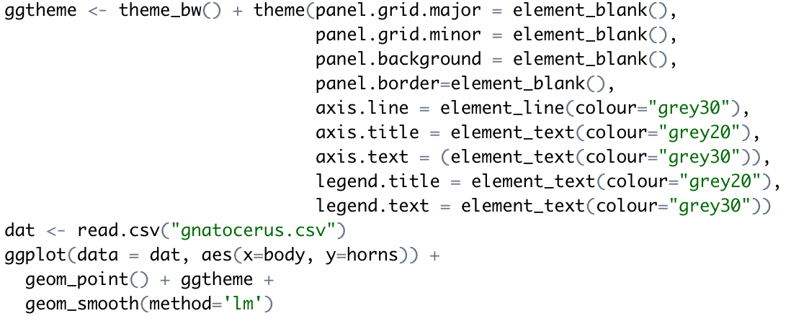
Making that plot

Slide 28
Strong Inference for Observational Studies
Noticing a pattern in the data and reporting it represents a post hoc analysis
This is not hypothesis testing
The results, while potentially important, must be interpreted cautiously
What can be done?
Based on a post-hoc observational study, construct a new hypothesis for a novel group or system that has not yet been studied

Slide 29
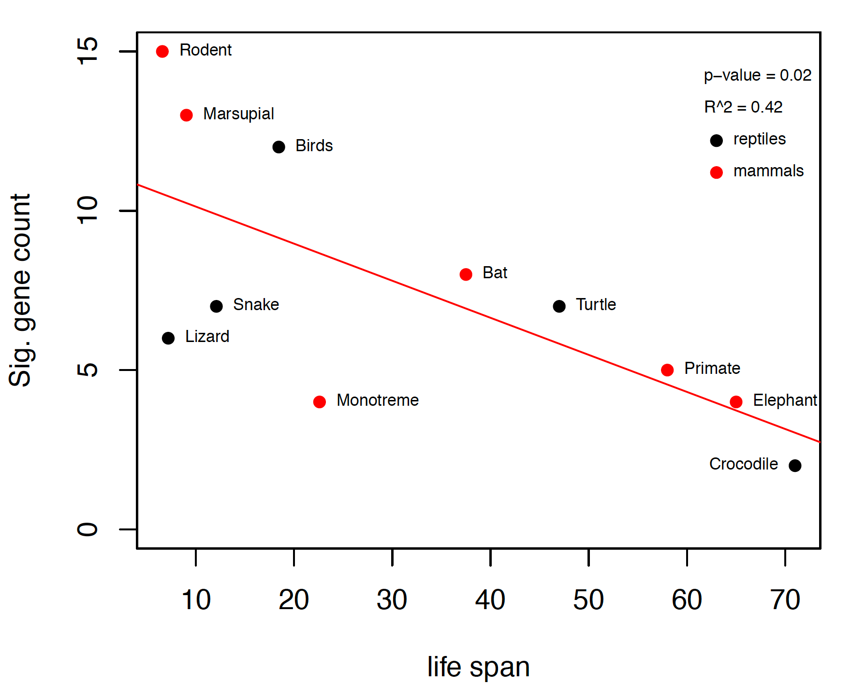
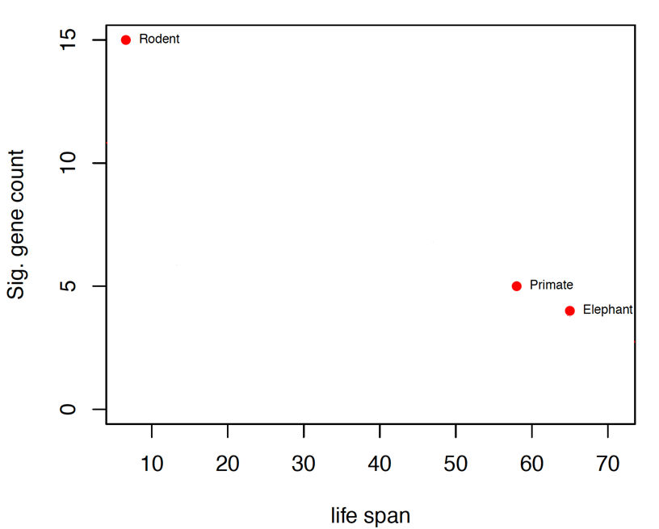
Example
We already knew that the P53 network is important in guarding against cancer in long lived species.
We also knew that primates and elephants show rather little change in this network when compared to rodents.
Collect data on many more species and test apriori hypothesis that there will be a significant and negative regression coefficient.

Slide 30
Assumptions of Linear Regression
The true relationship must be linear
At each value of X, the distribution of Y is normal (i.e., the residuals are normal)
The variance in Y is independent of the value of X
Note that there are no assumptions about the distribution of X

Slide 31
Common Problems
Outliers
Regression is extremely sensitive to outliers
The line will be drawn to outliers, especially along the x-axis
Consider performing the regression with and without outliers
Non-linearity
Best way to notice is by visually inspecting the plot and the line fit
Try a transformation to get linearity [often a log transformation]
Non-normality of residuals
Can be detected from a residual plot
Possibly solved with a transformation
Unequal variance
Usually visible from a scatterplot or from a residual plot

Slide 32
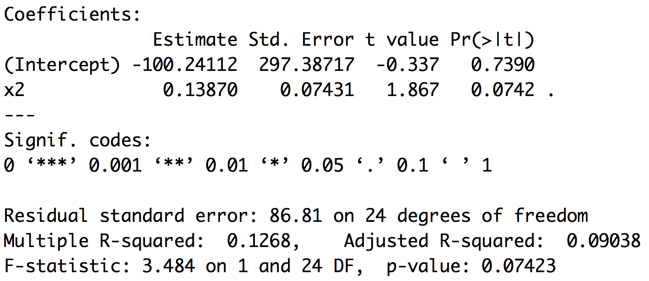
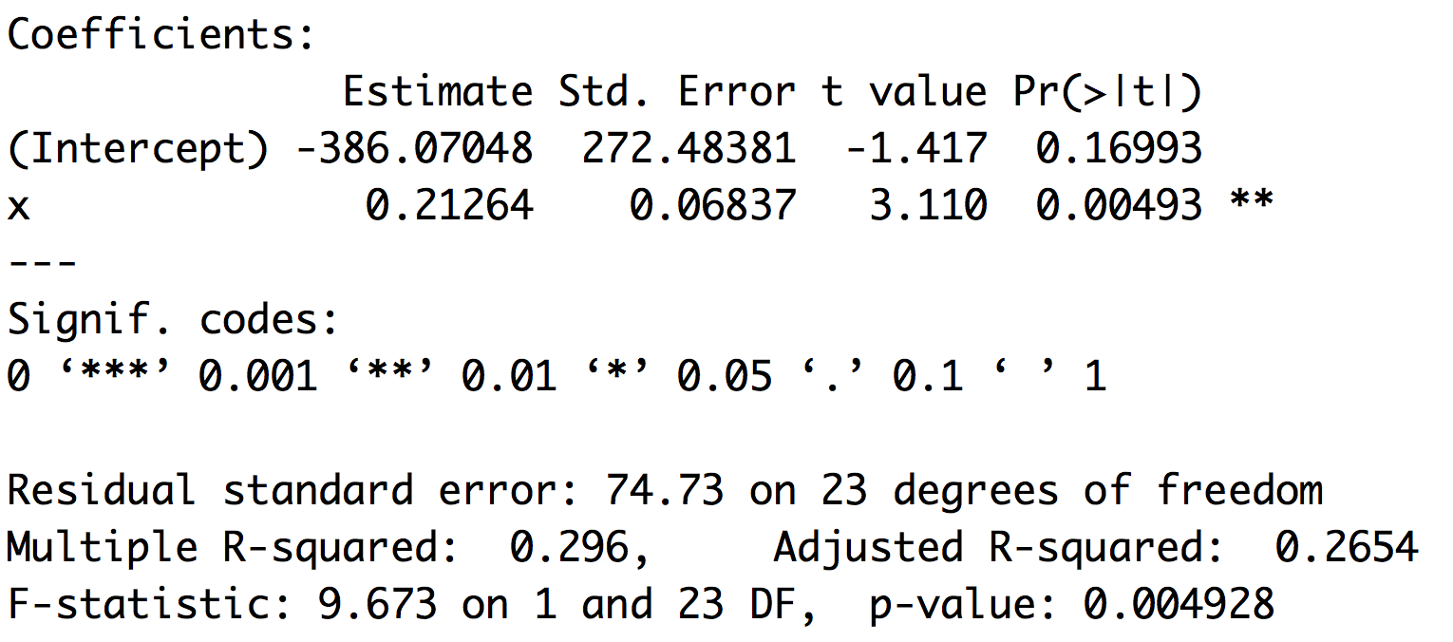
Outliers
Leverage and cooks distance
Theil–Sen estimator

Slide 33
Moving past simple models
The reason ANOVA is so widely used is that it provides a framework to simultaneously test the effects of multiple factors
ANOVA also makes it possible to detect interactions among the factors
ANOVA is a special case of a general linear model
Linear regression is a special case of a general linear model

Slide 34
GLM and LM function in R
The GLM and LM function in R takes equations that can be described with the following operators
+ +X include this variable
: X:Z include the interaction between these variables
∗ X∗Y include these variables and the interactions between them
^ (X + Z + W)^3 include these variables and all interactions up to three way

Slide 35
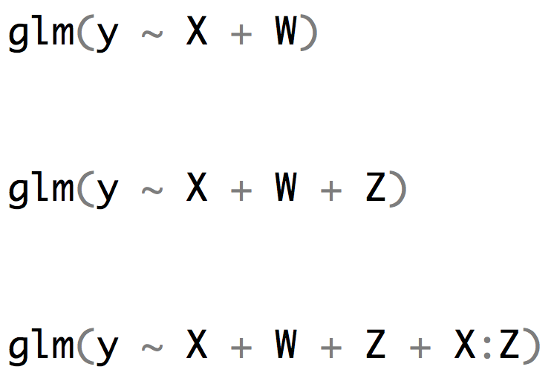
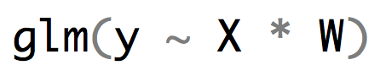
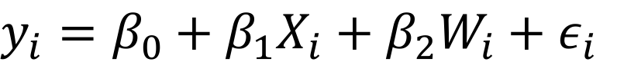
R versus the math implied
$y_{i}=β_{0}+β_{1}X_{i}+β_{2}W_{i}+ε_{i}$
$y_{i}=β_{0}+β_{1}X_{i}+β_{2}W_{i}+β_{3}{X_{i}W}_{i}+ε_{i}$

Slide 36
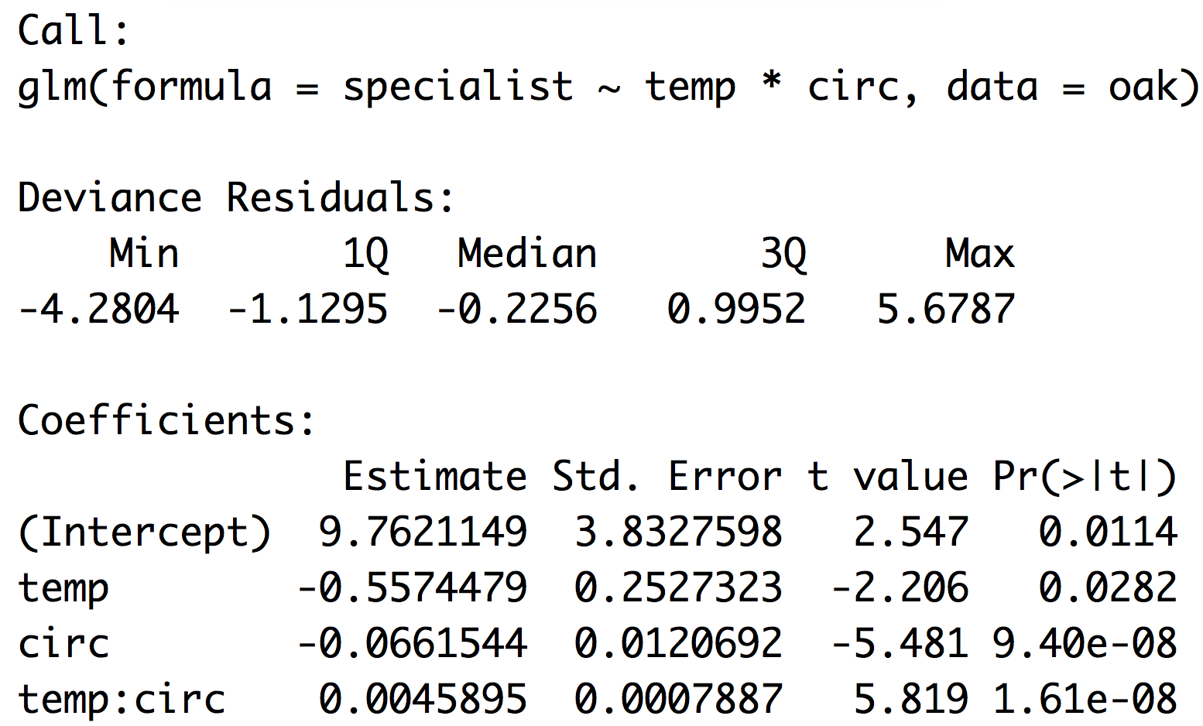
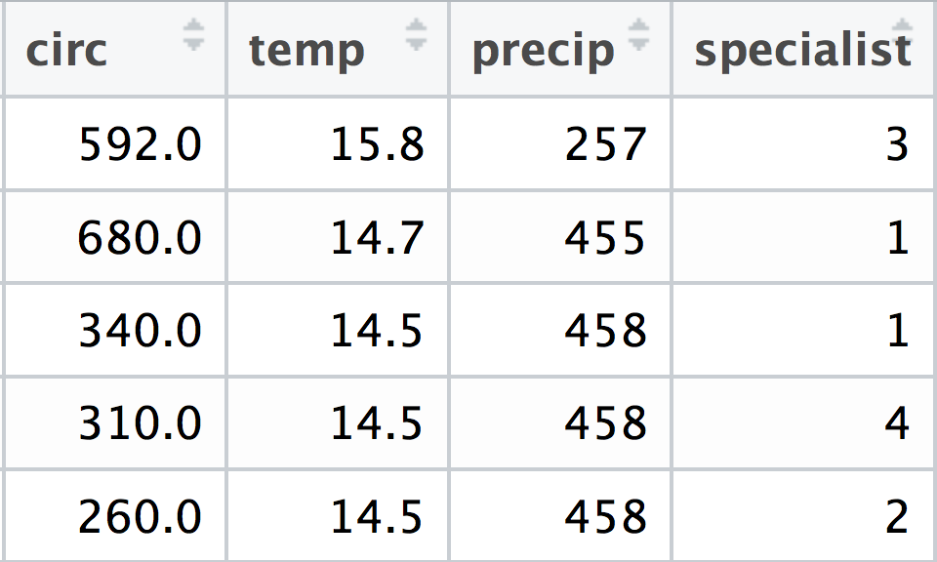
R versus the math oak example
$$y_{i}=β_{0}+β_{1}{temp}_{i}+β_{2}{circ}_{i}+β_{3}{{temp}_{i}circ}_{i}$$

Slide 37
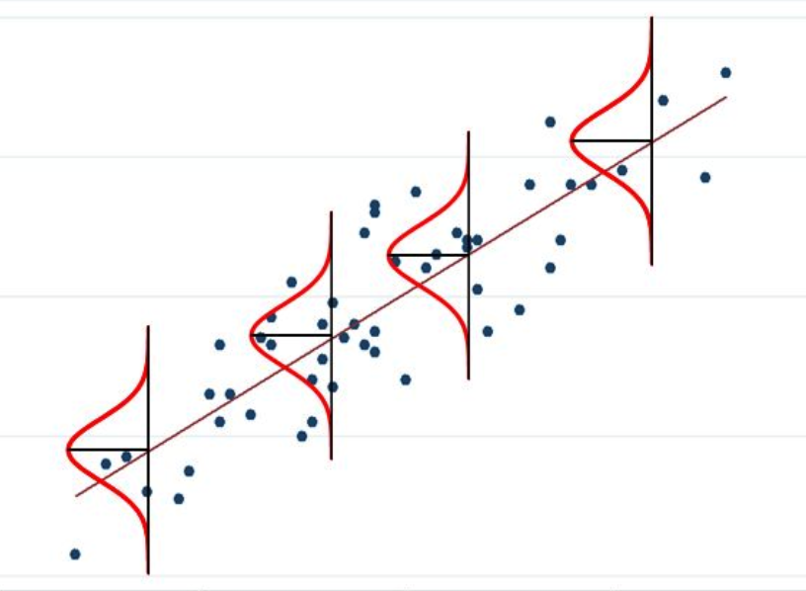
When the response variable isn’t normal

Slide 38
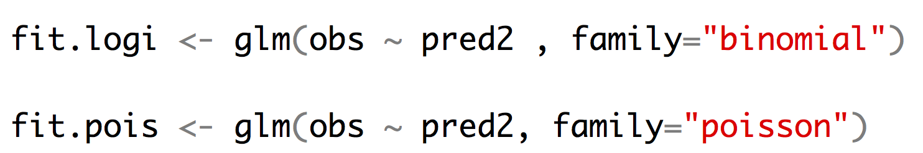
Other kinds of regression
Logistic regression allows us to fit a binary response variable (absent/present; alive/dead) with one or more categorical or continuous predictor variables.
Poisson regression allows us to fit a response variable that is Poisson distributed (number of extinctions in a unit of time, number of colonies per plate, (number of occurrences for rare events)) with one or more categorical or continuous predictor variables.

Slide 39
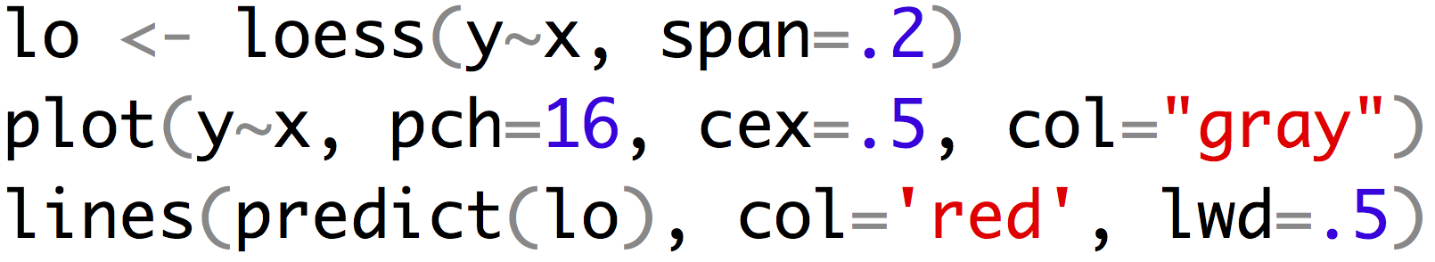
Sometimes regression isn’t best choice

